Slide 1
Momentum along with
Gradient Descent

Slide 2
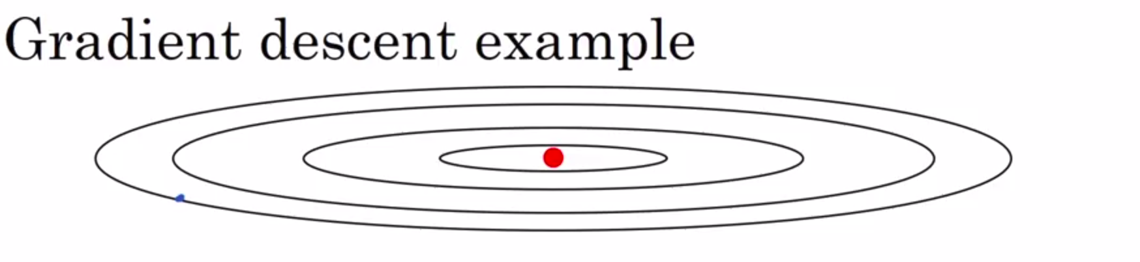
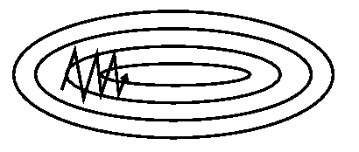
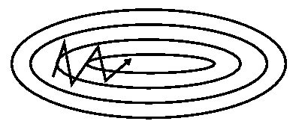
The Problem
Without Momentum With Momentum

Slide 3
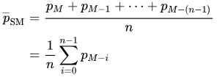


Exponential Moving Averages
Normal Average:
Cumulative Average:
Exponential Moving Average:
Source: https://en.wikipedia.org/wiki/Moving_average

Slide 4
Exponentially Moving Averages
Think of St as approximately averaging the last 1/(1-𝜶) data points
For example, 𝜶=0.9 ~last 10 observations, 𝜶=0.98 ~last 50 observations, 𝜶=0.5 ~last 2 observations
Question: How will the graph look?
Answer: Lesser number of past observations considered => more “raggedy” graph

Slide 5
Exponentially Moving Averages
Think of St as approximately averaging the last 1/(1-𝜶) data points
For example, 𝜶=0.9 ~last 10 observations, 𝜶=0.98 ~last 50 observations, 𝜶=0.5 ~last 2 observations
Question: How will the graph look?

Slide 6
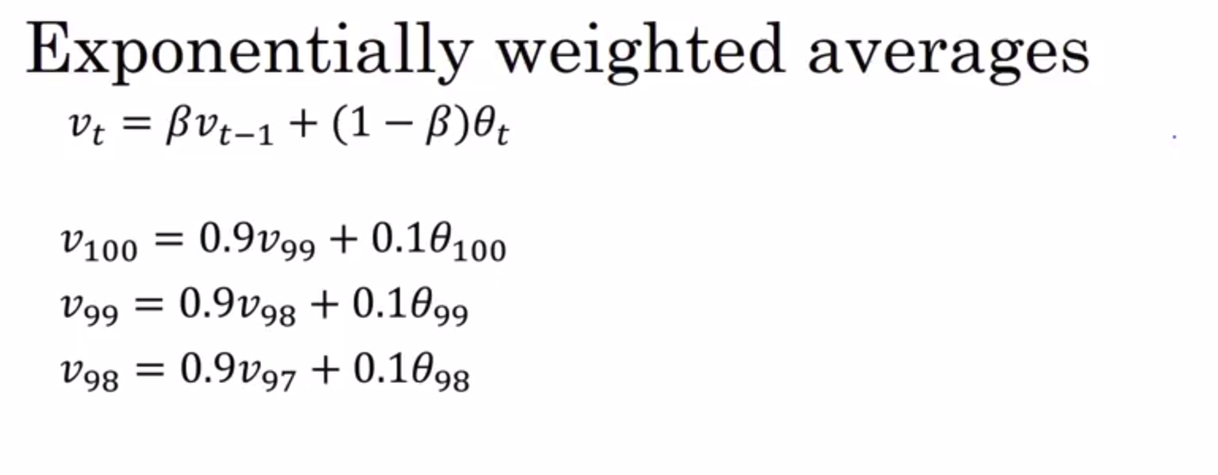
Understanding Exponentially Moving Averages
Initialize V0 as 0
Calculate V1 as a factor of only theta
Use Induction
Example for 𝜷 = 0.98
Source: Andrew Ng Coursera Deep Learning course

Slide 7
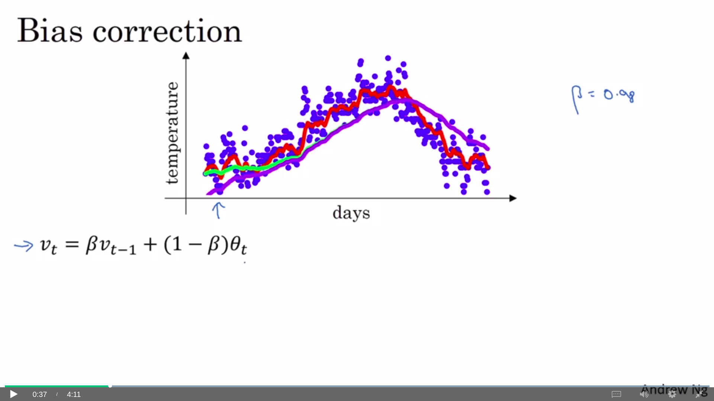
Bias Correction
Factor of 1/(1-𝜷**t) where t is the number of observations already seen
Lets try with V0 = 0 and 𝜷 = 0.98
If thetas are +ve, V2 is much lesser than either
Weighted Average

Slide 8
The Momentum Algorithm
Assumption: horizontal axis is W1 and vertical axis is W2, 𝜷 is momentum rate and 𝜶 is the learning rate
For each batch:
Calculate dW1, dW2
Vdw1 = 𝜷*Vdw1 + (1- 𝜷) dW1
Vdw2 = 𝜷*Vdw2 + (1- 𝜷) dW2
W1 = W1 - 𝜶*Vdw1; W2 = W2 - 𝜶*Vdw2
(Note, 1-𝜷 not present in some papers)

Slide 9
The Momentum Algorithm
Assumption: horizontal axis is W1 and vertical axis is W2, 𝜷 is momentum rate and 𝜶 is the learning rate
For each batch:
Calculate dW1, dW2
Vdw1 = 𝜷*Vdw1 + (1- 𝜷) dW1
Vdw2 = 𝜷*Vdw2 + (1- 𝜷) dW2
W1 = W1 - 𝜶*Vdw1; W2 = W2 - 𝜶*Vdw2
Question: what is the initial value of Vdw1, Vdw2?

Slide 10
The RMSProp Algorithm
Assumption: horizontal axis is W1 and vertical axis is W2 and 𝜶 is the learning rate
For each batch:
Calculate dW1, dW2
Sdw1 = 𝜷*Sdw1 + (1- 𝜷) dW1²
Sdw2 = 𝜷*Sdw2 + (1- 𝜷) dW2²
W1 = W1 - 𝜶*dw1/√Sdw1; W2 = W2 - 𝜶*dw2/√Sdw2

Slide 11
The RMSProp Algorithm
Assumption: horizontal axis is W1 and vertical axis is W2 and 𝜶 is the learning rate
For each batch:
Calculate dW1, dW2
Sdw1 = 𝜷*Sdw1 + (1- 𝜷) dW1²
Sdw2 = 𝜷*Sdw2 + (1- 𝜷) dW2²
W1 = W1 - 𝜶*dw1/√Sdw1; W2 = W2 - 𝜶*dw2/√Sdw2
AdaGrad update is exactly the same with 𝜷 = 0 (no decay) => more aggressive
Question: What is the initial value of Sdw1, Sdw2?

Slide 12
RMS Prop Intuition
Horizontal = W1, Vertical = W2
dW1 will be lesser in typical GD => Sdw1 will be lesser
dW2 will be higher in typical GD => Sdw2 will be higher
Net effect is we are better at avoiding over-shooting; also reach goal faster

Slide 13
Adam Optimization - Adaptive Momentum
For each batch:
Calculate dW1, dW2
Vdw1 = 𝜷₁*Vdw1 + (1- 𝜷₁) dW1 ; Vdw2 = 𝜷₁*Vdw2 + (1- 𝜷₁) dW2
Sdw1 = 𝜷₂*Sdw1 + (1- 𝜷₂) dW1² ; Sdw2 = 𝜷₂*Sdw2 + (1- 𝜷₂) dW2²
Vdw1^{corrected} = Vdw1/(1- 𝜷₁^{t}) , Vdw2^{corrected} = Vdw2/(1- 𝜷₁^{t})
Sdw1^{corrected} = Sdw1/(1-𝜷₂^{t}), Sdw2^{corrected} = Sdw2/(1-𝜷₂^{t})
W1 = W1 - 𝜶*Vdw1^{corrected}/√Sdw1^{corrected}
W2 = W2 - 𝜶*Vdw2^{corrected}/√Sdw2^{corrected}

Slide 14
Adam - continued
Adam = Adaptive Momentum Estimation
3 Hyperparameters:
𝜷₁: usually 0.9
𝜷₂: usually 0.99 or 0.999
𝜶 : unfortunately, still needs to be tuned
Also, add an ε along with SdWs to avoid NaNs

Slide 15
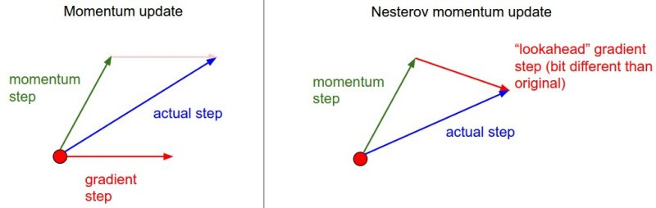
Nesterov Momentum
Better convergence guarantees for convex algorithms
Deals in points: v = mu * v - learning_rate * dx
x += v

Slide 16
Which algorithm to use when?

Slide 17
Learning Rate Decay
Intuition: At the beginning, we want higher 𝜶, then lesser as we get closer to the goal
Idea: Say, you want to decay 𝜶 at the rate d after every N observations
Then, after xN observations (x>0)
𝜶 = 𝜶₀/(1+ d*x )
Note: to increase the learning rate, use something like 𝜶 = d*𝜶₀/(1+ x )

